Slide 1
Laptop Specs in Relation to Price
A. Otis & H. Yu Chen
COMP 4442-2
June 9th, 2022

Slide 2
Data Source
The data was discovered on Kaggle, the primary resource being scrapped data from flipkart.com; collected from a chrome extension app called “Instant Data Scrapper”.
Included are relevant to factors that are suggested to affect laptop prices, such as company name and owned laptop brands, the price of the laptop when first released and later in product’s life, among other tech related specifications.
Responses in columns were transformed into multivariate (i.e. 1, 2, 3, …, etc.) form. Additionally, another column is added for a logistic transformation of the response variable.
Raw Set:
Observations = 896
Attributes = 34
Analysis ready Set:
Observations = 896
Attributes = 35

Slide 3

Bayesian Data Analysis, in Principle
There exists two established frameworks regarding the field of statistics, Frequentist and Bayesian. Frequentist being the framework we are now all well familiar with (e.g p-values and point estimate for variable of interest as a result), our group is utilizing the Bayesian framework, which results in a distribution.
$$Bayes Theorem: P\left(A | B\right) α P\left(B | A\right)P\left(A\right)$$
$$Where,$$
$$P\left(A | B\right)→Posterior Distribution$$
$$P\left(B | A\right)→Likelihood Distribution, assuming event A has occured, what is probability of event B?$$
$$P\left(A\right)→Prior Distribution, Inital guess of the variable of interest$$
A resulting posterior distribution can be interpreted as a report on both the level certainty and uncertainty (i.e. $±0, ±1, …,±n standard deviations )$regarding the probability of an event and model parameters

Slide 4
Research Question
What is the probability of a laptop’s market price
Given various of commonly used specifications in the industry?
Specification examples:
Ssd
Hdd
Ram

Slide 5

Bayesian Regression
To get our Prior Distribution, we will simply run a regular multiple regression. Without industry expert input, this type of prior is commonly referred to as a “non-informative prior”
$$y_{i}=\left(β_{0}+β_{1}x_{1}+…+β_{n}x_{n}\right)+(ε_{i}) , for data (x_{n}, y_{n})$$
$$Where, ε_{i}←Noise$$
To get our Likelihood Distribution the model runs thousands of samples, each with their own likelihood parameter; which together create a distribution of the likelihood parameters.
Specifically, we will be utilizing the JAGS package.
Notes:
We’re no strangers for linear regression, so consider this presentation as an extension of what we’ve learned so far (i.e. Linear Regression from a Bayesian Perspective).

Slide 6
Data Satisfaction
1. Linearity
(i.e.) Linear relationship between predictors and response
2. Homoscedasticity
(i.e.) Residuals vs Fitted show that variance remains about the same for any value of predictor variables
3. Independence
(i.e.) Residual vs Factor Plot shows random dispersal about a horizontal trend line
4. Normality
(i.e.) Residuals provide a well fit QQ-plot
Predictor Variables:
ram_gb
ssd
hdd
Response Variable:
log.latest_price
Notes:
1.
2.
3.
4.

Slide 7
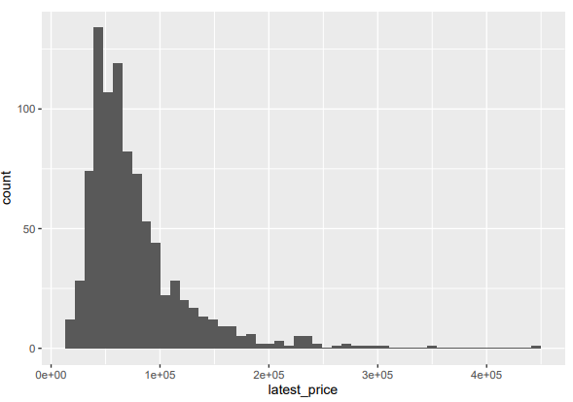
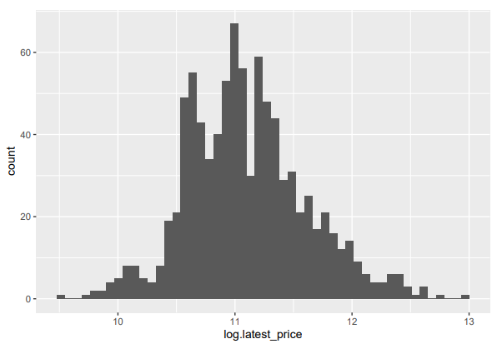
Exploratory Analysis
Log transformation
Non-Transformed Response
Transformed Response

Slide 8
Algorithm: Markov chain Monte Carlo (MCMC)
Imagine a target distribution you want to analyze, have data on it, but can no longer collect the data? The solution would be to use the Markov Chain Monte Carlo (MCMC). Thus, MCMC is simply a algorithm for sampling from a distribution.
One of the most common ways MCMC is used is to draw samples from the posterior probability distribution of some model in Bayesian inference
Regarding Analysis,
Four Markov Chains are set up for the predictors, “brand”, “ram_gb”, “hdd”, “ssd”
Notes:
At this point Andrew will have briefly explained the Algorithm’s connection to the analysis

Slide 9
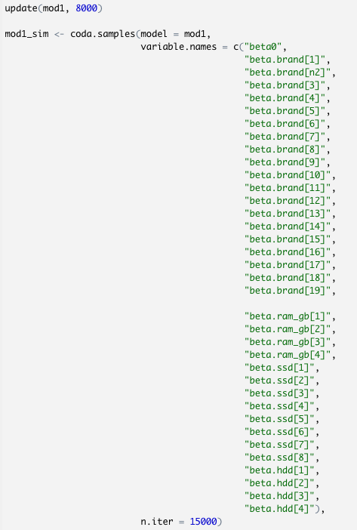
Run MCMC Sampler
Burn-in (i.e. iterations) is a technique that helps improve the outcome quality.
the goal is to keep the model outcomes that closely match the real word data to build our posterior distribution (i.e. confirmation if the MCM chains have converged)
Notes:
*****IMPORTANT*****
Testing Gauss Assumptions - What are the names of the plots?
Plot 1 = QQ plot
Plot 2 =
*******UNRESOLVED*****************
What it happening (Technically):
“burn-in” period of 8000 (i.e.) , and the simulation is ran 1500 times (i.e. “iterations”), We decided to build the model after the 8000th period

Slide 10
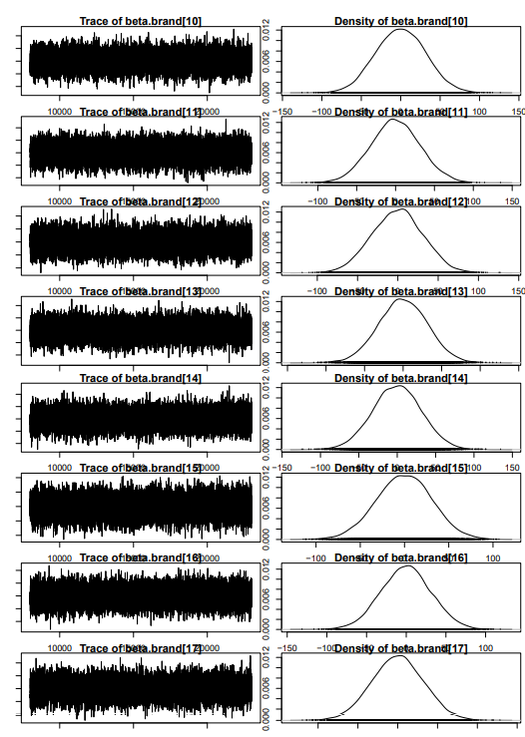
MCMC Diagnostics (Posterior Distributions)
In trace plots, we want to try to avoid any flat areas or too many consecutive steps in one direction, indicative of chains not converging.
Posterior distributions look relatively smooth and the mixing among chains, all good signs for convergence!
Notes:
*****IMPORTANT*****
Do we have a version of the plots with better formatted titles(i.e. not overlapping one another)?
*******UNRESOLVED*****************
What it happening (Technically):
each of the chain obtains randomly obtains the initial values via the rnorm() and rgarmma() functions in Rstudio.

Slide 11
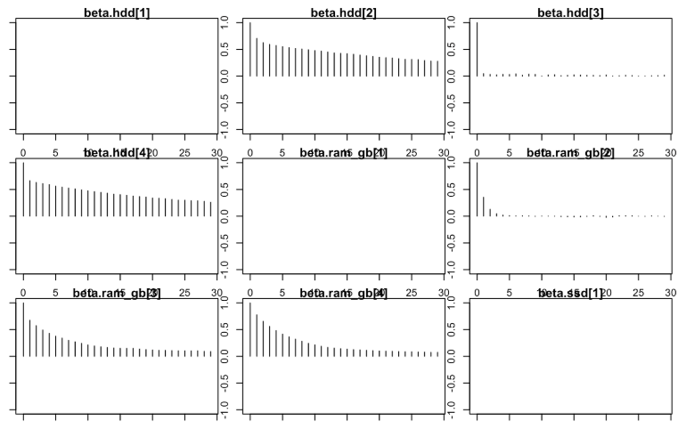
MCMC Diagnostics
Another way to check for convergence is to look at the autocorrelations between the samples returned by our MCMC.
The lag-k autocorrelation is the correlation between every sample and the sample k steps before. This autocorrelation should become smaller as k increases, (i.e. samples can be considered as independent. )
Notes:
The lag-k autocorrelation is the correlation between every sample and the sample k steps before. This autocorrelation should become smaller as kk increases, i.e. samples can be considered as independent.
What it happening (Technically):
For example, the beta.ram_gb variable, the p-value for beta.ram_gb[2] is 0.582172 and have the plot only having only two bars. Next, the p-value of beta.ram_gb[3] and beta.ram_gb[4] are less than 2e-16 and 8.65e-13 respectively which is significant and shows a path on the plots

Slide 12
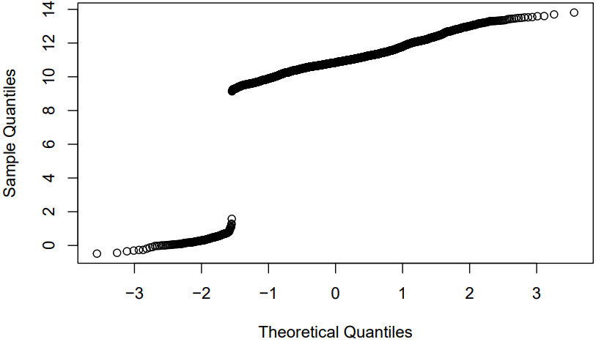
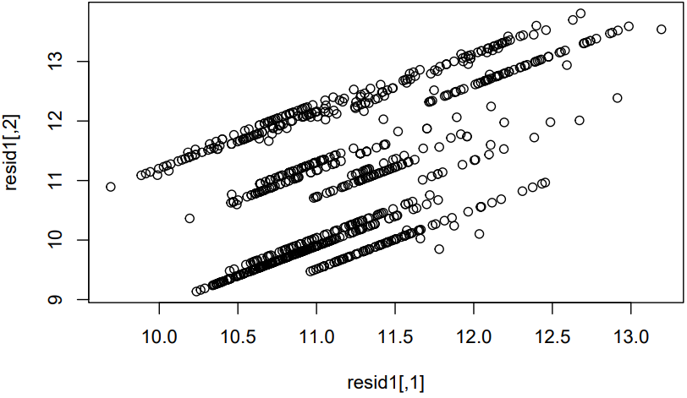
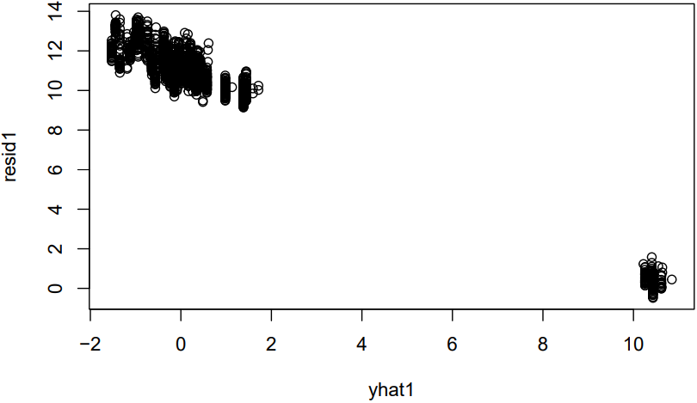
Model Validity w/ Brand Included
Below are Diagnostic plots of the Bayesian Regression model fit on the data set, with inclusion of the variable “Brand” from a vector of predicted model values
Check Normality
QQ-Plot
Check Independence
Residuals vs Factor
Check Linearity
Residuals vs Fitted plot
Notes:
*****IMPORTANT*****
Testing Gauss Assumptions - What are the names of the plots?
Plot 1 = QQ plot
Plot 2 = Residuals vs Factors
Why Is y-axis here different when compared to the model without brands included?
Plot 3 = Residuals vs Fitted
A non-random pattern suggests that a simple linear model is not appropriate; you may need to transform the response or predictor, or add a quadratic or higher term to the mode.
Meaning behind the statement?
“For the Quantiles for each variable are looking for the group that are not passing 0 in the interval”
*******UNRESOLVED*****************
What it happening (Technically):
For example, the beta.ram_gb variable, the p-value for beta.ram_gb[2] is 0.582172 and have the plot only having only two bars. Next, the p-value of beta.ram_gb[3] and beta.ram_gb[4] are less than 2e-16 and 8.65e-13 respectively which is significant and shows a path on the plots

Slide 13
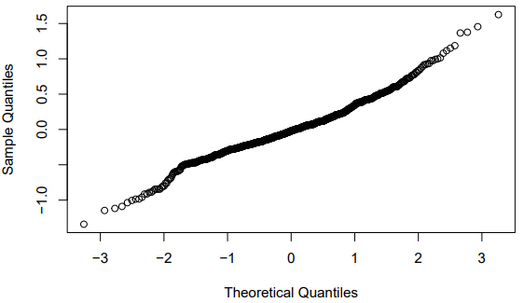
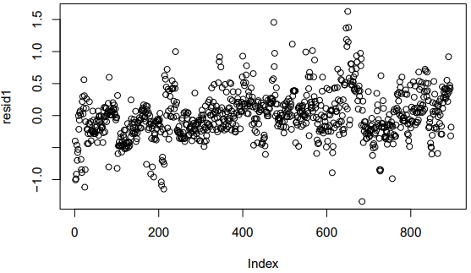
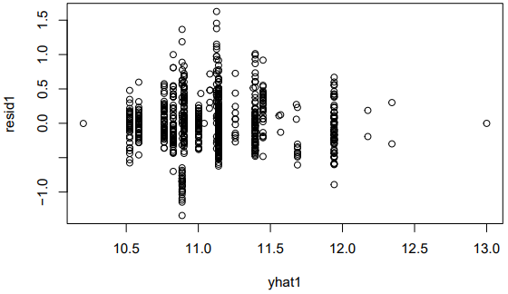
Model Validity w/o Brand Included
Below are Diagnostic plots of the Bayesian Regression model fit on the data set, excluding the variable “Brand” from a vector of predicted model values
Check Normality
QQ-Plot
Check Independence
Residuals vs Factor
Check Linearity
Residuals vs Fitted plot
Notes:
*****IMPORTANT*****
Testing Gauss Assumptions - What are the names of the plots?
Plot 1 = QQ plot
Plot 2 = Residuals vs factors
A pattern that is not random suggests lack of independence.
Plot 3 = Residuals vs Fitted
*******UNRESOLVED*****************
What it happening (Technically):
For example, the beta.ram_gb variable, the p-value for beta.ram_gb[2] is 0.582172 and have the plot only having only two bars. Next, the p-value of beta.ram_gb[3] and beta.ram_gb[4] are less than 2e-16 and 8.65e-13 respectively which is significant and shows a path on the plots

Slide 14
Conclusions
The Bayesian regression model with brands included do not fit our data well. However, the Bayesian model with brands excluded did fit the data well, and therefore would result in more valid results/interpretations.
It is possible that the brand portion of the data is oversaturated with one type of response (e.g. majority of responses consisting of the most popular products at the time).
Thus, the model with brands included could be improved by the following.
The removal of brands that have no significant effect (i.e. MCM chains related to that variable not converging).
Re-specifying the parameters for the posterior distribution
More data can be collected regarding brands and added into the model to see if more valid results come out.
Recall, Research Question: What is the probability of a laptop’s market price. Given various of commonly used specifications in the industry?
While our presentation does not answer this question, it does provide a great starting point in the form of a model that fits the data. We recommend any further study on the topic follow up with predictions made with the Bayesian Regression model

Slide 15
References
Videos:
Bayesian Modeling with R and Stan (Reupload). (2018, November 15). [Video]. YouTube.
Bayesian Statistics - Regression with JAGS Part 3. (2021, May 24). [Video]. YouTube.
Literature/Academic:
A. (2022, May 16). Bayesian Statistics Overview and your first Bayesian Linear Regression Model. Towardsdatascience. Retrieved June 6, 2022.
Durso, C. (2022), COMP4442-2: Advanced Probability and Statistics 2.
Falster, D. F. R. (2013, June 10). Markov Chain Monte Carlo - Nice R Code. Github. Retrieved June 1, 2022.
Karajannis, N. (2017, November 20). RPubs - Bayes Regression using JAGS. Rpubs.Com. Retrieved May 28, 2022.
Htoon, K. S. (2021, December 13). Log Transformation: Purpose and Interpretation - Kyaw Saw Htoon. Medium. Retrieved June 6, 2022.
Sbnfk. (2019). mcmc_diagnostics.utf8.md. Github. Retrieved June 2, 2022.
Data:
Laptop Specs and latest price. (2022, April 3). Kaggle.

